Slide 1
Advanced Cryptography
Danish Khan
Professor
School of Computer Technology
George Brown College, Casa Loma Campus

Slide 2
Objectives
Define digital certificates
List the various types of digital certificates and how they are used
Describe the components of Public Key Infrastructure (PKI)
List the tasks associated with key management
Describe the different transport encryption protocols
Notes:
Objectives
Define digital certificates
List the various types of digital certificates and how they are used
Describe the components of Public Key Infrastructure (PKI)
List the tasks associated with key management
Describe the different transport encryption protocols

Slide 3
Digital Certificates
Digital Certificates
A common application of cryptography
Using digital certificates involves
Understanding their purpose
Knowing how they are managed
Determining which type of digital certificate is appropriate for different situations
Notes:
Digital Certificates
Digital Certificates
A common application of cryptography
Using digital certificates involves
Understanding their purpose
Knowing how they are managed
Determining which type of digital certificate is appropriate for different situations

Slide 4
Defining Digital Certificates
Digital signature
Used to prove a document originated from a valid sender
Weakness of using digital signatures
They only show that the private key of the sender was used to encrypt the digital signature
Imposter could post a public key under a sender’s name
Notes:
Defining Digital Certificates
Digital signature
Used to prove a document originated from a valid sender
Weakness of using digital signatures
They only show that the private key of the sender was used to encrypt the digital signature
Imposter could post a public key under a sender’s name

Slide 5
Defining Digital Certificates
Trusted third party
Used to help solve the problem of verifying identity
Verifies the owner and that the public key belongs to that owner
Helps prevent man-in-the-middle attack that impersonates owner of public key
A digital certificate is a technology used to associate a user’s identity to a public key
That has been “digitally signed” by a trusted third party
Notes:
Defining Digital Certificates
Trusted third party
Used to help solve the problem of verifying identity
Verifies the owner and that the public key belongs to that owner
Helps prevent man-in-the-middle attack that impersonates owner of public key
A digital certificate is a technology used to associate a user’s identity to a public key
That has been “digitally signed” by a trusted third party

Slide 6
Defining Digital Certificates
Information contained in a digital certificate
Owner’s name or alias
Owner’s public key
Issuer’s name
Issuer’s digital signature
Digital certificate’s serial number
Expiration date of the public key
Notes:
Defining Digital Certificates
Information contained in a digital certificate
Owner’s name or alias
Owner’s public key
Issuer’s name
Issuer’s digital signature
Digital certificate’s serial number
Expiration date of the public key

Slide 7
Managing Digital Certificates
Technologies used for managing digital certificates
Certificate Authority (CA)
Registration Authority (RA)
Certificate Repository (CR)
Notes:
Managing Digital Certificates
Technologies used for managing digital certificates
Certificate Authority (CA)
Registration Authority (RA)
Certificate Repository (CR)
Certificate Authority (CA)
Serves as the trusted third party agency
Responsible for issuing digital certificates
A CA can be internal or external to an organization

Slide 8
Types of Digital Certificates
Different categories of digital certificates
The most common categories are:
Personal digital certificates
Server digital certificates
Software publisher digital certificates
Notes:
Types of Digital Certificates
Different categories of digital certificates
The most common categories are:
Personal digital certificates
Server digital certificates
Software publisher digital certificates

Slide 9
Types of Digital Certificates
Class 1: Personal Digital Certificates
Issued by an RA directly to individuals
Frequently used to secure e-mail transmissions
Typically only require user’s name and e-mail address to receive
Class 2: Server Digital Certificates
Issued from a Web server to a client
Ensure authenticity of the Web server
Ensure authenticity of the cryptographic connection to the Web server
Notes:
Types of Digital Certificates
Class 1: Personal Digital Certificates
Issued by an RA directly to individuals
Frequently used to secure e-mail transmissions
Typically only require user’s name and e-mail address to receive
Class 2: Server Digital Certificates
Issued from a Web server to a client
Ensure authenticity of the Web server
Ensure authenticity of the cryptographic connection to the Web server

Slide 10
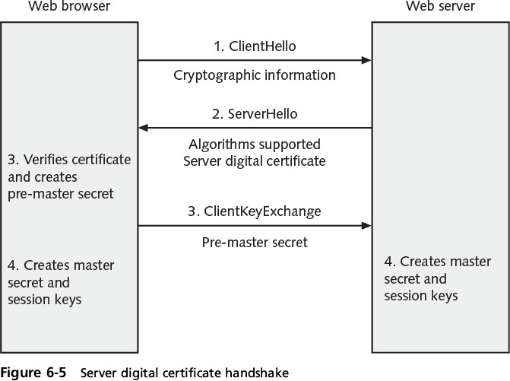
Types of Digital Certificates
Notes:
Types of Digital Certificates
Figure 6-5 Server digital certificate handshake

Slide 11
Types of Digital Certificates
Class 2: server digital certificates (cont’d.)
Server authentication and secure communication can be combined into one certificate
Displays padlock icon in the Web browser
Click padlock icon to display information about the digital certificate
Extended Validation SSL Certificate (EV SSL)
Requires more extensive verification of legitimacy of the business
Notes:
Types of Digital Certificates
Class 2: server digital certificates (cont’d.)
Server authentication and secure communication can be combined into one certificate
Displays padlock icon in the Web browser
Click padlock icon to display information about the digital certificate
Extended Validation SSL Certificate (EV SSL)
Requires more extensive verification of legitimacy of the business

Slide 12
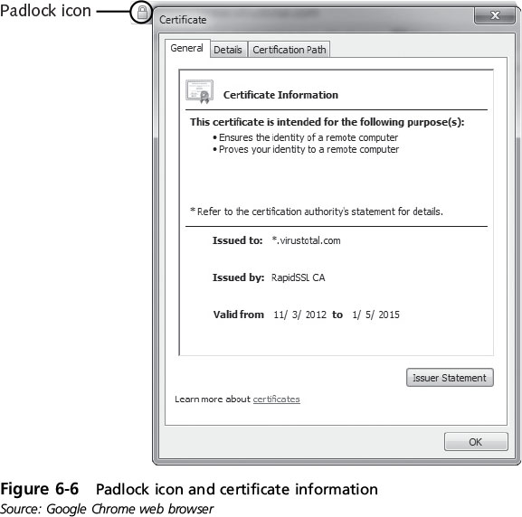
Types of Digital Certificates
Notes:
Types of Digital Certificates
Figure 6-6 Padlock icon and certificate information

Slide 13
Types of Digital Certificates
Class 3: Software Publisher Digital Certificates
Provided by software publishers
Purpose: to verify programs are secure and have not been tampered with
X.509 digital certificates
The standard for the most widely accepted format for digital certificates
Digital certificates following this standard can be read or written by any application that follows X.509
The current version is X.509 v3
Notes:
Types of Digital Certificates
Class 3: Software Publisher Digital Certificates
Provided by software publishers
Purpose: to verify programs are secure and have not been tampered with
X.509 digital certificates
The standard for the most widely accepted format for digital certificates
Digital certificates following this standard can be read or written by any application that follows X.509
The current version is X.509 v3

Slide 14
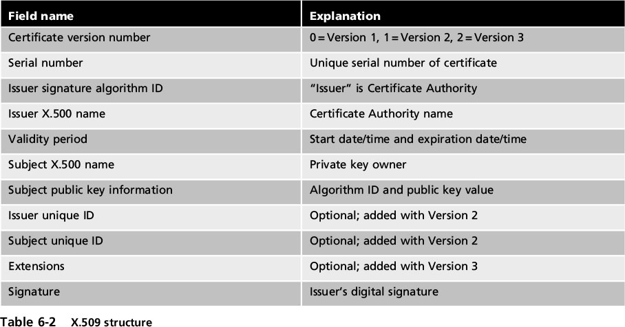
Types of Digital Certificates
Notes:
Types of Digital Certificates
Table 6-2 X.509 structure

Slide 15
Downloading and Installing a DC
https://www.comodo.com/home/email-security/free-email-certificate.php
Go for a free certificate.
For Windows you need ‘certmgr.msc’ and add certificates under ‘Personal.

Slide 16
Public Key Infrastructure (PKI)
Important management tool for the use of:
Digital certificates:
Asymmetric cryptography
Aspects of PKI
Public-key cryptography standards
Trust models
Managing PKI
Notes:
Public Key Infrastructure (PKI)
Important management tool for the use of:
Digital certificates:
Asymmetric cryptography
Aspects of PKI
Public-key cryptography standards
Trust models
Managing PKI

Slide 17
What is Public Key Infrastructure?
There is a need for a consistent means to manage digital certificates
Public key infrastructure (PKI) - a framework for all entities involved in digital certificates
Certificate management actions facilitated by PKI
Create
Store
Distribute
Revoke
Notes:
What is Public Key Infrastructure?
There is a need for a consistent means to manage digital certificates
Public key infrastructure (PKI) - a framework for all entities involved in digital certificates
Certificate management actions facilitated by PKI
Create
Store
Distribute
Revoke

Slide 18
Public-Key Cryptographic Standards (PKCS)
PKCS - A numbered set of PKI standards defined by the RSA Corporation
Widely accepted in the industry
Based on the RSA public-key algorithm
PKCS is composed of the 15 standards.
Notes:
Public-Key Cryptographic Standards (PKCS)
PKCS - A numbered set of PKI standards defined by the RSA Corporation
Widely accepted in the industry
Based on the RSA public-key algorithm
PKCS is composed of the 15 standards detailed in Table 6-3 on page 241 of the text

Slide 19
Cryptographic Transport Protocols
Secure Sockets Layer (SSL)
One of the most common transport algorithms
Developed by Netscape
Design goal was to create an encrypted data path between a client and a server
Transport Layer Security (TLS)
Versions starting with v1.1 are significantly more secure than SSL v3.0
Notes:
Cryptographic Transport Protocols
Secure Sockets Layer (SSL)
One of the most common transport algorithms
Developed by Netscape
Design goal was to create an encrypted data path between a client and a server
Transport Layer Security (TLS)
Versions starting with v1.1 are significantly more secure than SSL v3.0

Slide 20
Cryptographic Transport Protocols
Cipher suite
A named combination of the encryption, authentication, and message authentication code (MAC) algorithms that are used with SSL and TLS
Length of keys - a factor in determining the overall security of a transmission
Keys of less than 2048 bits are considered weak
Keys of 2048 bits are considered good
Keys of 4096 bits are strong
Notes:
Cryptographic Transport Protocols
Cipher suite
A named combination of the encryption, authentication, and message authentication code (MAC) algorithms that are used with SSL and TLS
Length of keys - a factor in determining the overall security of a transmission
Keys of less than 2048 bits are considered weak
Keys of 2048 bits are considered good
Keys of 4096 bits are strong

Slide 21
Secure Shell (SSH)
An encrypted alternative to the Telnet protocol used to access remote computers
It is a Linux/UNIX-based command interface and protocol
SSH is a suite of three utilities: slogin, ssh, and scp
Client and server ends of the connection are authenticated using a digital certificate and passwords are encrypted
Can be used as a tool for secure network backups
Notes:
Secure Shell (SSH)
An encrypted alternative to the Telnet protocol used to access remote computers
It is a Linux/UNIX-based command interface and protocol
SSH is a suite of three utilities: slogin, ssh, and scp
Client and server ends of the connection are authenticated using a digital certificate and passwords are encrypted
Can be used as a tool for secure network backups

Slide 22
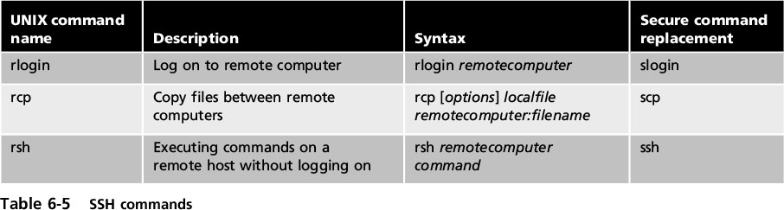
Secure Shell (SSH)
Notes:
Secure Shell (SSH)
Table 6-5 SSH commands

Slide 23
SSL Server and Client Tests
Online test to determine the security of web servers and local web browser.
www.ssllabs.com/ssltest/index.html

Slide 24
Hypertext Transport Protocol Secure (HTTPS)
A common use of TLS and SSL:
To secure Hypertext Transport Protocol (HTTP) communications between browser and Web server
The secure version is actually “plain” HTTP sent over SSL or TLS
Called Hypertext Transport Protocol Secure (HTTPS) and uses port 443 instead of HTTP’s port 80
Users must enter URLs with https://
Notes:
Hypertext Transport Protocol Secure (HTTPS)
A common use of TLS and SSL:
To secure Hypertext Transport Protocol (HTTP) communications between browser and Web server
The secure version is actually “plain” HTTP sent over SSL or TLS
Called Hypertext Transport Protocol Secure (HTTPS) and uses port 443 instead of HTTP’s port 80
Users must enter URLs with https://

Slide 25
IP Security (IPsec)
Internet Protocol Security (IPsec)
A suite of protocols for securing IP communications
Encrypts and authenticates each IP packet of a session between hosts or networks
IPsec considered to be a transparent protocol
It is transparent to the following:
Applications
Users
Software
Notes:
IP Security (IPsec)
Internet Protocol Security (IPsec)
A suite of protocols for securing IP communications
Encrypts and authenticates each IP packet of a session between hosts or networks
IPsec considered to be a transparent protocol
It is transparent to the following:
Applications
Users
Software

Slide 26
IP Security (IPsec)
IPsec provides three areas of protection that correspond to three IPsec protocols:
Authentication
Confidentiality
Key management
Supports two encryption modes:
Transport - encrypts only the data portion of each packet and leaves the header unencrypted
Tunnel - encrypts both the header and the data portion
Notes:
IP Security (IPsec)
IPsec provides three areas of protection that correspond to three IPsec protocols:
Authentication
Confidentiality
Key management
Supports two encryption modes:
Transport - encrypts only the data portion of each packet and leaves the header unencrypted
Tunnel - encrypts both the header and the data portion

Slide 27
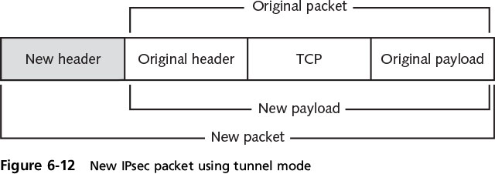
IP Security (IPsec)
Notes:
IP Security (IPsec)
Figure 6-12 New IPsec packet using tunnel mode

Slide 28
Summary
Digital signatures can be used to show the identity of the sender
Digital certificates provides third party verification of public key owner’s identity
A Certificate Authority issues digital certificates for others
Personal digital certificates are issued by an RA to individuals
The most widely accepted format for digital certificates is the X.509 international standard
Notes:
Summary
Digital signatures can be used to show the identity of the sender
Digital certificates provides third party verification of public key owner’s identity
A Certificate Authority issues digital certificates for others
Personal digital certificates are issued by an RA to individuals
The most widely accepted format for digital certificates is the X.509 international standard

Slide 29
Summary
PKI is a framework for all entities involved in digital certificates
Three basic PKI trust models exist
Cryptography can protect data as it is being transported across a network
SSL and TLS are widely used protocols
IPsec is a set of protocols developed to support the secure exchange of packets
Notes:
Summary
PKI is a framework for all entities involved in digital certificates
Three basic PKI trust models exist
Cryptography can protect data as it is being transported across a network
SSL and TLS are widely used protocols
IPsec is a set of protocols developed to support the secure exchange of packets

